Slide 1
George enescu –Romanian pianist,violonist and composer

Slide 2
Year of birth
George Enescu was born on 19th of August 1881 and died on 4th of May 1955.
He was a Romanian composer, violinist, pianist, conductor, and teacher. He is regarded by many as Romania's most important musician.

Slide 3
Biography
Enescu was born in the village of Liveni (later renamed "George Enescu" in his honor), in Dorohoi County at the time, today Botoşani County. He showed musical talent from early in his childhood.
The earliest work has the title Pămînt românesc ("Romanian Land") and it was composed when he was five years and a few months.

Slide 4
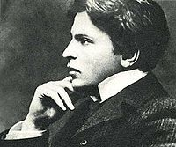
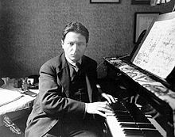
Pictures of young and mature george enescu

Slide 5
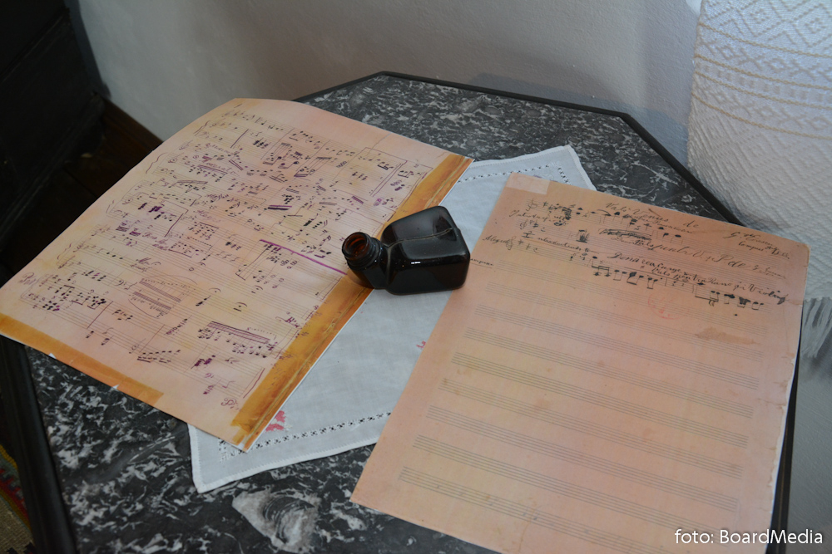
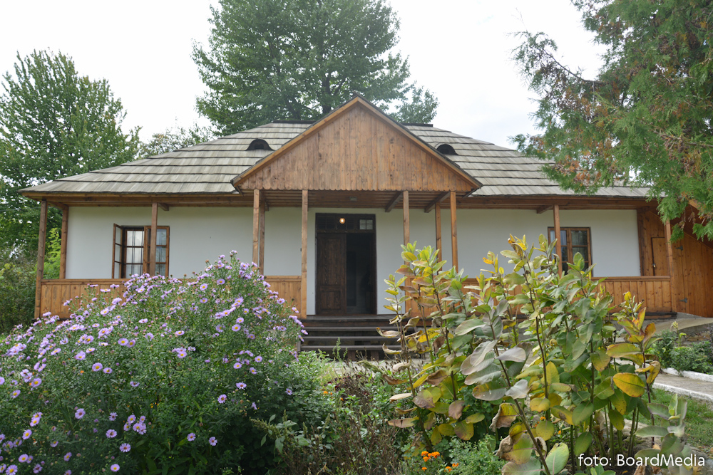
Pictures from liveni with his home

Slide 6
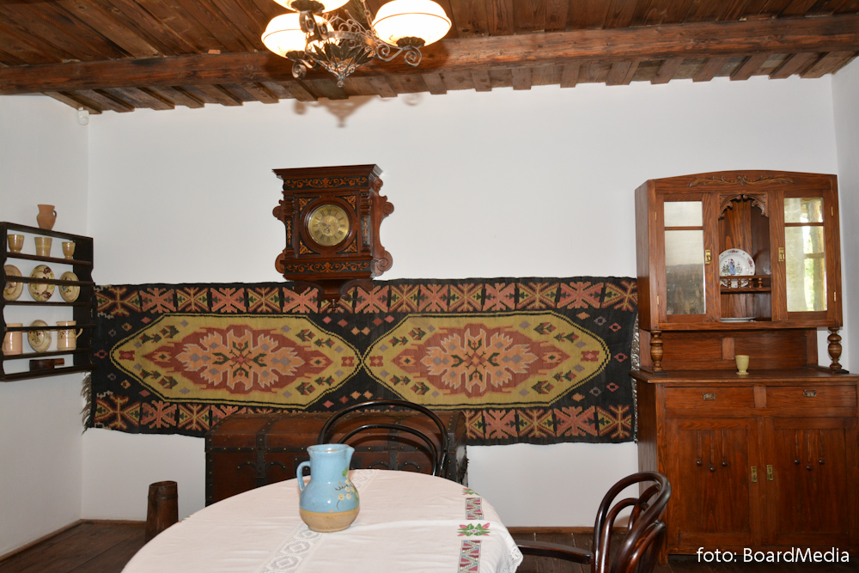
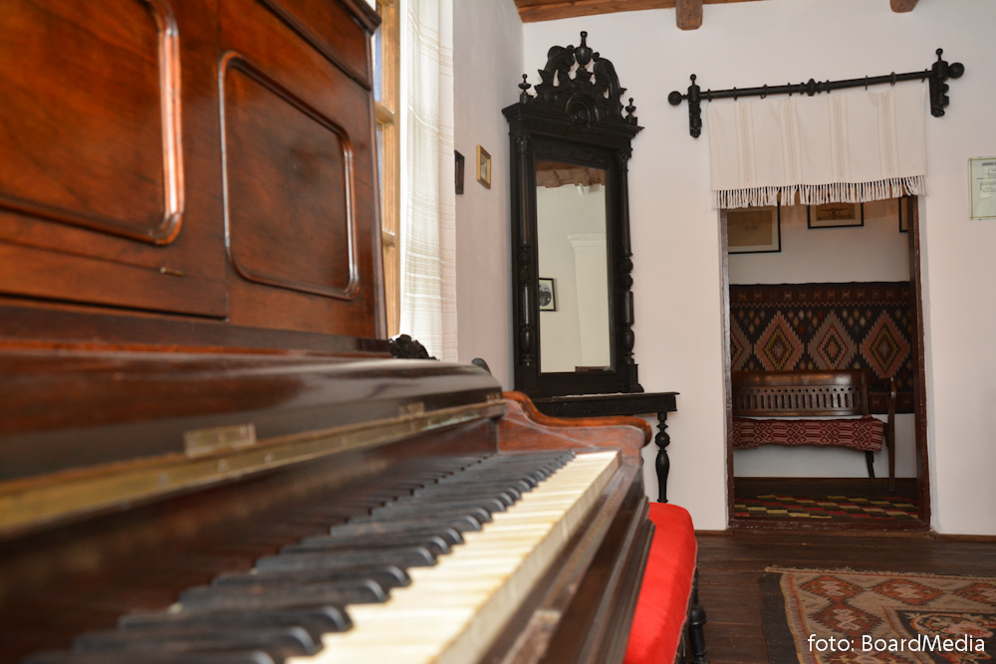

Slide 7
Reception
Pablo Casals described Enescu as "the greatest musical phenomenon since Mozart" and "one of the greatest geniuses of modern music".
Queen Marie of Romania wrote in her memoirs that "in George Enescu was real gold".
Yehudi Menuhin, Enescu's most famous pupil, once said about his teacher: "He will remain for me the absoluteness through which I judge others. [...].

Slide 8
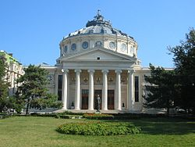
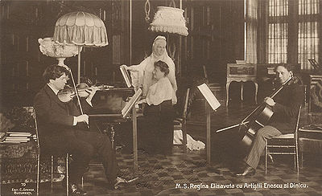
Filarmonica "George Enescu"- Queen Elisabeth of Romania with Romanian Athenaeum, Bucharest George Enescu at Peles Castle

Slide 9
death
On his death in 1955, George Enescu was burried in Père Lachaise Cemetery in Paris.
Today, Bucharest houses a museum in his memory; likewise, the Symphony Orchestra of Bucharest and the George Enescu Festival—founded by his friend, musical advocate, and sometime collaborator, the conductor George Georgescu are named and held in his honor.

Slide 10
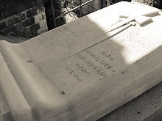
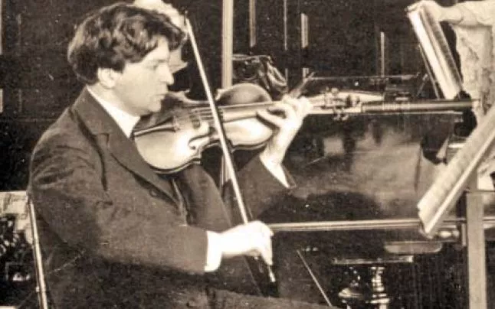
George Enescu ‘s grave
-Père Lachaise Cemetery

